Slide 1

Health Insurance Management
Team Members:-
1.Karthika V
2.Kaviya Raj P
3.Agilesh R
4.Badrinath G
5.Emil Antony

Slide 2
The Health Insurance Management System (HIMS) is a Java-based console application developed to manage health insurance members and policies efficiently.
It demonstrates the use of Object-Oriented Programming principles such as classes, inheritance, and encapsulation.
The system provides admin functionalities for policy management, member registration, upgrades, and claims.
Introduction

Slide 3
Objective of Project
To design and develop a console-based application that helps administrators handle health insurance policies and members.
To implement OOP cocepts in Java effectively.
To allow administrators to manage member creation, assignment, claims, and reports seamlessly.
To maintain data consistency using HashMap collections.

Slide 4
About the Project
This project simulates the operations of a health insurance company where an admin manages all policyholders.
Members can be added, upgraded, or removed from the system.
The system calculates claims, total revenue, and supports policy upgrades based on income.
It’s a menu-driven console program demonstrating real-world object mapping in Java.

Slide 5
Project Details
Technologies Used:
Programming Language: Java
IDE: Eclipse
Paradigm: Object-Oriented Programming
Collections Used: HashMap (for storing Members and Plans)
Execution: Console/Terminal

Slide 6
Project Details
Core Packages:
Entity → Defines classes like Members and plans
DAO → Data Access Objects (HIMSDAO)
Services → Core business logic (add, remove, claim, upgrade, report)
Main → Entry point handling admin menu

Slide 7
Major Modules
Plans Module (plans.java)
Defines insurance plan details: ID, name, premium, claim limit, and checkups.
Displays available health plans.
Member Module (Members.java)
Stores member details such as ID, name, age, gender, address, salary, and assigned plan.
Service Module (service.java, remove.java, upgrading_plans.java).
Handles member addition, claims, upgrades, and removal.

Slide 8
Major Modules
Utility Module (UtilityFunctions.java)
Generates detailed reports and displays member details.
Validation Module (Validation.java)
Ensures input correctness and type safety for user data.
Main Module (Main.java)
Controls menu navigation and calls the appropriate services.

Slide 9
Roles
Kavya Raj P:
Created Members class and methods
Create methods to add members and assign policy plans to each members.
Aghilesh R:
Display available policy plans.
Created policy class and methods
Method to remove members.

Slide 10
Roles
Karthika V:
Created user interface.
Created methods to upgrade members’ policy plans if they meet the requirements.
Emil Antony:
Created methods for admin to view summary of all members and details of each member.
Created report generation function.
Implemented function which allows members to claim insurance money.

Slide 11
Roles
Badrinath G:
Created and implemented hash maps for storage and retrieval of member and policy details.
Created validation mechanism to ensure only proper inputs are accepted.
Integrated various methods to work seamlessly with each other.

Slide 12
Duration
Requirement Gathering -1 day
System Design -1 day
Implementation and Coding-1 day
Testing and Debugging – 1 day
Document & Review-1 day

Slide 13
Approach
Object-Oriented Design:
Real-world entities modeled as classes (Members, Plans).
Modular Programming:
Clear separation of DAO, Entity, and Service layers.
Data Management:
Use of HashMap for quick access and modification.
Validation
Input checked for correctness to avoid runtime errors.
Menu-driven Interaction
User-friendly console interface for admin operations.

Slide 14
Report
Object-Oriented Design: Real-world entities modeled as classes (Members, Plans).
Modular Programming: Clear separation of DAO, Entity, and Service layers.
Data Management: Use of HashMap for quick access and modification.
Validation: Input checked for correctness to avoid runtime errors.
Menu-driven Interaction: User-friendly console interface for admin operations.

Slide 15
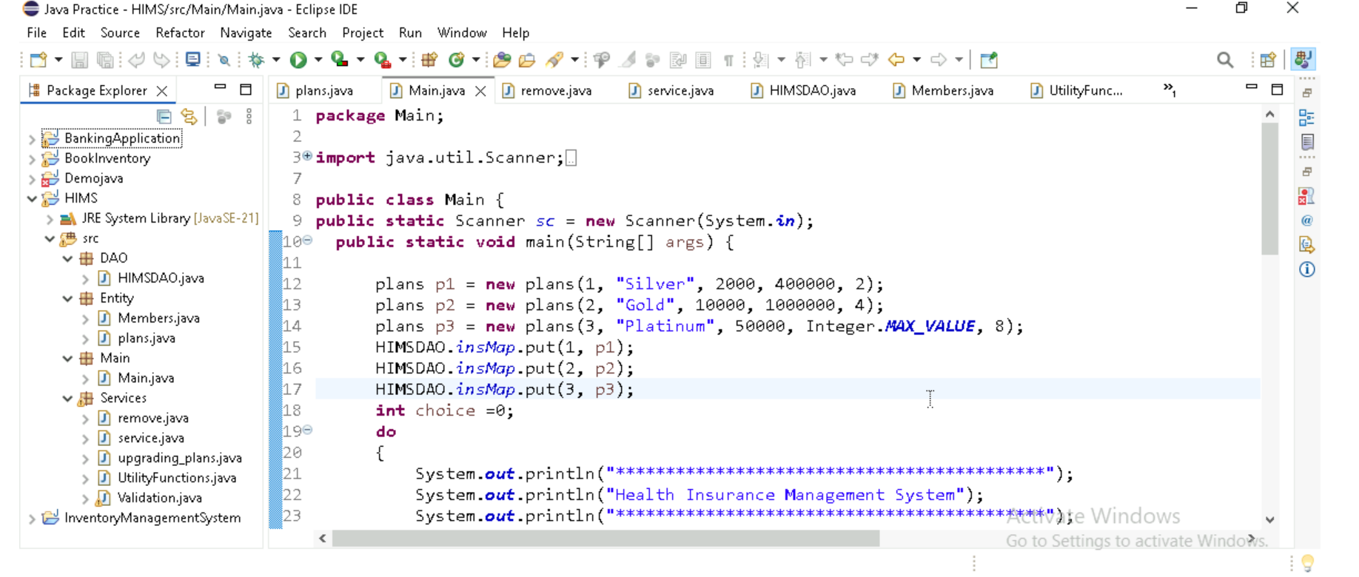
Result:-

Slide 16
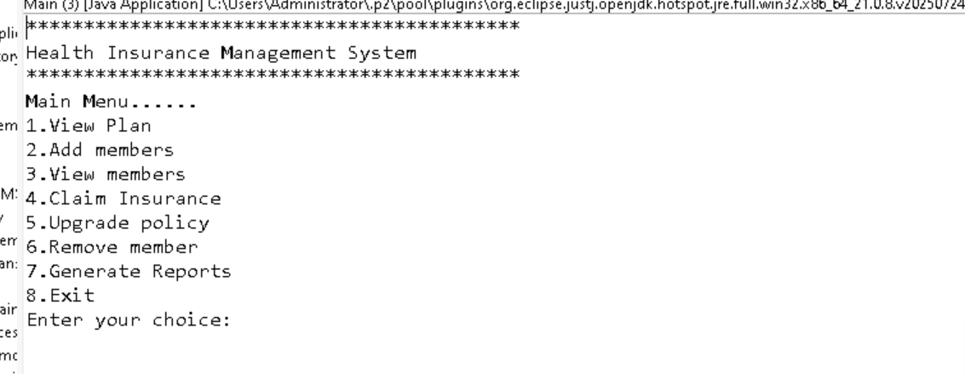
Result:-

Slide 17
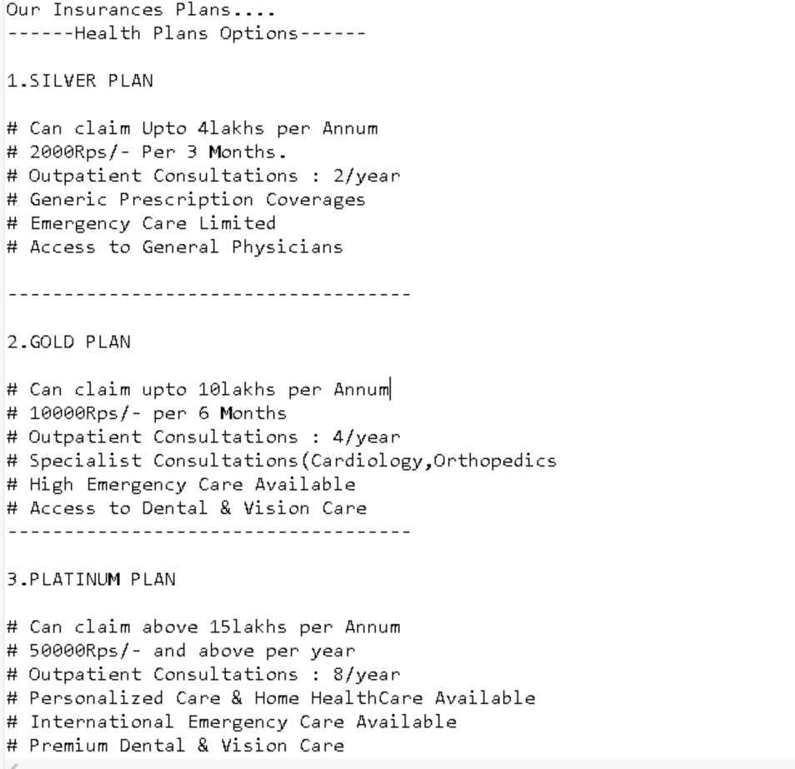
Result:-

Slide 18
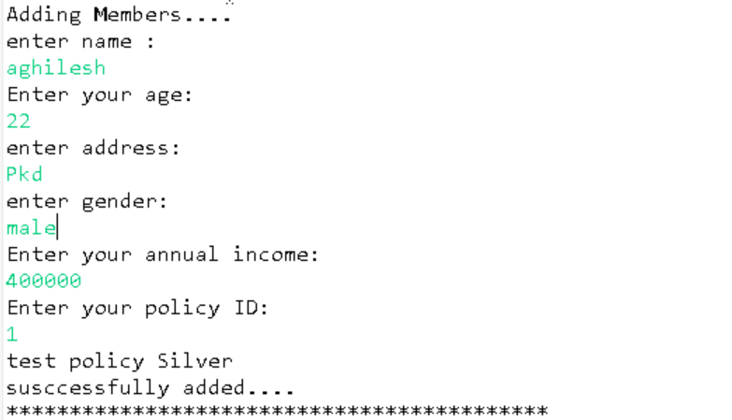
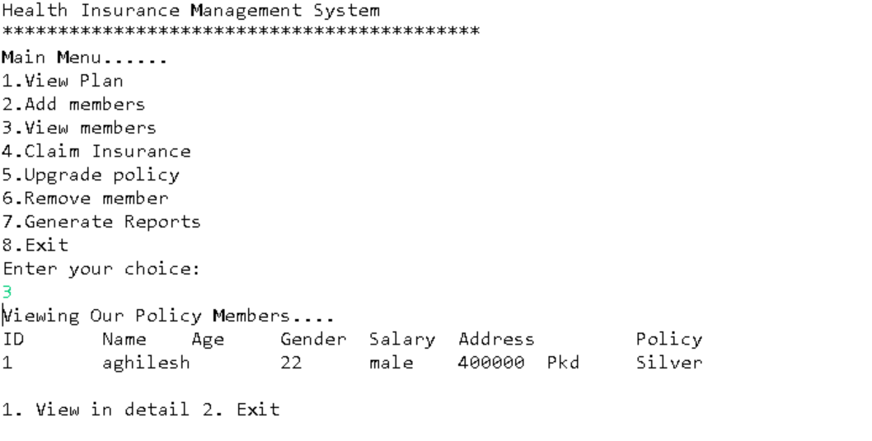
Result:-

Slide 19
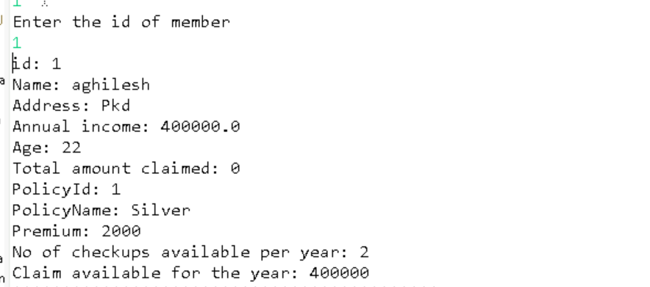
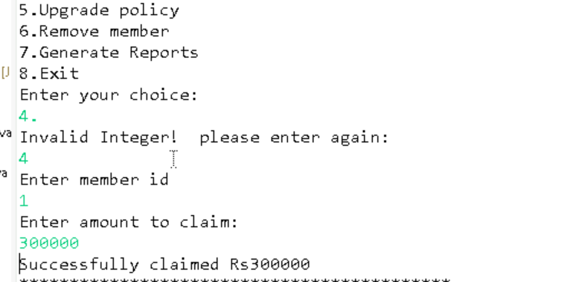
Result:-

Slide 20
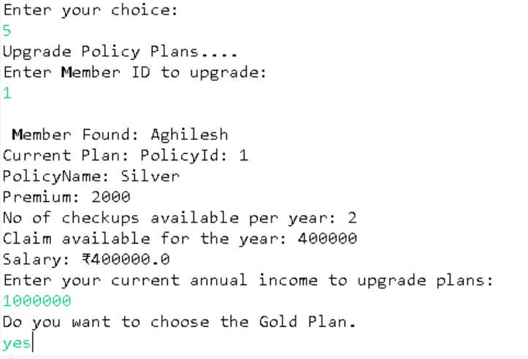
Result:-

Slide 21
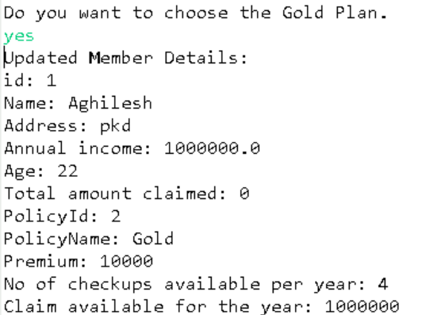
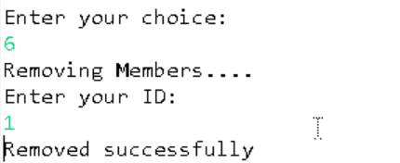
Result:-

Slide 22
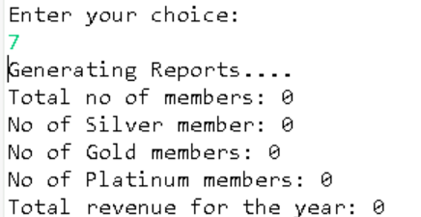

Result:-

Slide 23
Conclusion
The Health Insurance Management System successfully demonstrates how Java OOP can model real-world scenarios.
It efficiently manages health insurance operations such as member addition, claims, and policy upgrades.
The system is modular, scalable, and a strong foundation for future improvements such as:
GUI-based front-end
Database storage
User login and authentication

